Slide 1

Generative AI Beyond Standalone LLMs: Practical RAG Applications
Presented by: Dr. Durga Karthik

Slide 2
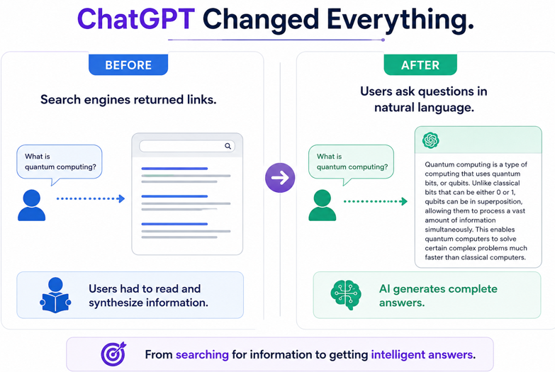
What Happened on 30 November 2022?

Slide 3
What is Artificial Intelligence?
AI enables machines to perform tasks requiring human intelligence.
Examples: Face recognition, speech recognition, translation, recommendations.

Slide 4
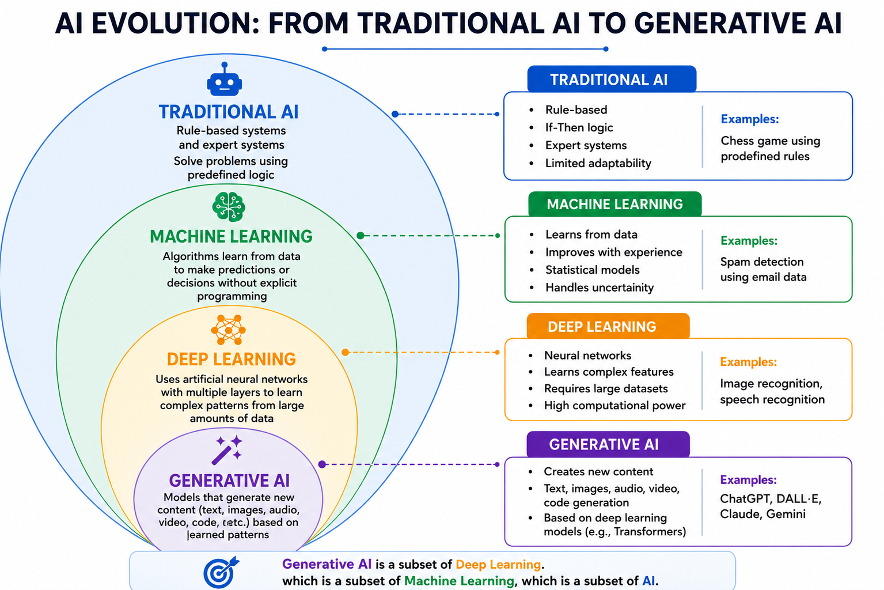

Slide 5
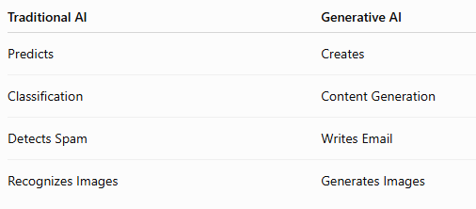
Generative AI vs Traditional AI
Example
Traditional AI Generative AI
Is this email spam? Draft a professional email.

Slide 6
What is Generative AI?
Creates new content instead of merely analysing data.
Can generate : Text, Images, Audio, Video, Code.
Examples:
ChatGPT – Multi modal LLM
Gemini – Multi modal LLM
Claude – Multi modal LLM
Llama 3- LLM (primarily text)
DALL-E – Image Generation Model

Slide 7
What is a Large Language Model (LLM)?
AN LLM is a neural network trained on massive amount of text.
Examples: ChatGPT, Gemini, Claude, Llama.
Learns : Grammar, Facts, Patterns, Reasoning
Does Not Learn Like Humans
It Predicts the next most probable token using Transformer arch-
Attention is All you need- Neural Information Processing systems -2017
Notes:
Human learning by experience, observation, reasoning, common sense. Suppose when we touc a hot stove. We learn : Hot stove->pain -> avoid touching againg
LLM learning
During training It may see
The capital of INDIA IS NewDelhi
New Delhi is capital of India
India’s capital city is New Delhi
It learns that
India->Capital->New Delhi

Slide 8
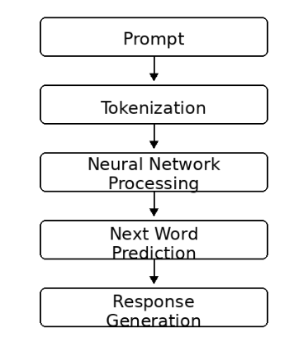
How an LLM Works ?
Parallel Processing on
all tokens
Self Attention captures relationships Training faster
scalable

Slide 9
Example Prompt in ChatGpt: India is famous for
Possible Next Word | Probability (Illustrative)
its | 35%
cricket | 20%
diversity | 18%
culture | 15%
spices | 7%
technology | 5%
India is famous for
↓
Predict next word:
"its"
↓
India is famous for its
↓
Predict next word:
"rich"
↓
India is famous for its rich
↓
Predict next word:
"culture"
↓
India is famous for its rich culture
LLMs do not understand facts like humans; they learn patterns from massive amounts of text. They generate responses by predicting (not understanding) the most likely next word (token).

Slide 10
How Gen AI supports Faculty
Teaching: lesson plans, question papers,result analysis…
Research: literature reviews.
Administration: reports and accreditation documents.

Slide 11
Limitations
1. Hallucination
2. Knowledge Cutoff
3. Domain-Specific Knowledge Gap

Slide 12
Hallucination
AI may generate convincing but incorrect information.
LLMs generate probable text, not verified facts.
Real world examples
Now : It has better training, instruction tuning, fact verification, Web access to avoid hallucination.
Also,now it is trained to say : I donot know
Mata v. Avianca (Fake Court Cases) - 2023
Google Bard – James Webb Telescope Error
Fake Academic References/Citations
Air Canada Chatbot Bereavement Fare Case

Slide 13
Knowledge Cutoff
Models may not know events or updates beyond their training period.

Slide 14
Domain-Specific Knowledge Gap
Example: Latest NBA DETAILS
University policies may not be present in training data.

Slide 15
The Need for RAG
RAG = Retrieval + Knowledge Base + LLM
✓ Accesses external documents
✓ Reduces hallucinations
✓ Generates document-grounded answers

Slide 16
